Slide 1

MIGHTY CRACKER
We could consider using the Mighty Cracker Logo located in the Network Folder
Chris Bugg Chris Hamm Jon Wright Nick Baum
Notes:
Chris B, Chris H, Jon, Nick -> “Our project is Mighty Cracker”

Slide 2
Password Security
Password security is important.
Users
Weak and/or reused passwords
Developers and Admins
Choose insecure storage algorithms.
Mighty Cracker
Show real world impact of poor password security.
Notes:
Nick

Slide 3
OVERVIEW
We made a hash cracker.
Passwords are stored as hashes to protect them from intruders.
Our program uses several methods to ‘crack’ those hashes.
Networking
Spread work to multiple machines.
Cross Platform
Notes:
Nick

Slide 4
OTHER HASH CRACKING PRODUCTS
Hashcat
Cain and Abel
John the Ripper
THC-Hydra
Ophcrack
Network support is rare.
Notes:
Nick

Slide 5
WHAT IS HASHING
A way to encode a password to help protect it.
A mathematical one-way function.
MD5 hash
cf4ff726403b8a992fd43e09dd7b5717
SHA-256 hash
951e689364c979cc3aa17e6b0022ce6e4d0e3200d1c22dd68492c172241e0623
Notes:
Chris H
Hash is Popcorn

Slide 6
SUPPORTED HASHING ALGORITHMS
Current Algorithms
MD5
SHA-1
SHA-224
SHA-256
SHA-384
SHA-512
Notes:
Chris H

Slide 7
WAYS TO CRACK
Cracking Modes
Single User
Network Mode
Methods of Cracking:
Brute Force
Dictionary
Rainbow Table
GUI or Console
Notes:
Jon

Slide 8
BRUTE FORCE
Systematically checking all possible keys until the correct one is found.
Worst case this would transverse the entire search space.
Slowest but will always find the solution if given enough time.
Notes:
Jon

Slide 9
DICTIONARY ATTACK
List of common passwords from leaks/hacks.
Many people choose common passwords
Written works of Shakespeare ~66,000 words
Oxford English Dictionary ~290,000 words
Small dictionary = 900,000 words
Medium dictionary = 14 million words
Large dictionary = 1.2 billion words
Notes:
Jon

Slide 10
RAINBOW TABLE
Can’t store all possible hash/key combinations.
16 character key = 10^40th combinations
10^50th atoms on earth
Rainbow tables
Reduced storage.
More computation.
Storage can still be immense.
Far faster than other methods.
Notes:
Chris B

Slide 11
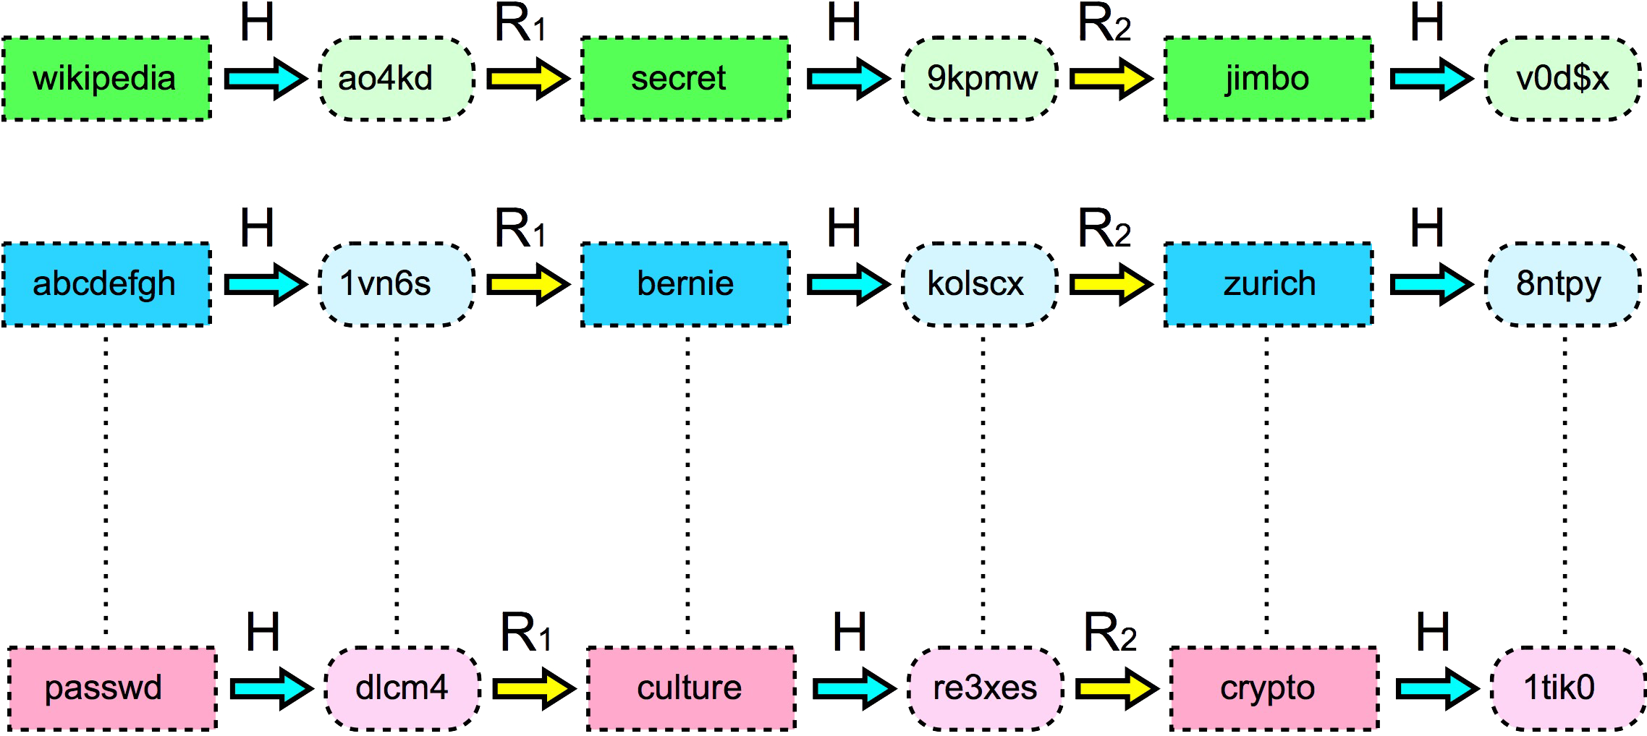
RAINBOW TABLE (HOW IT WORKS)
Tables are generated by repeated use of hash and reduce functions.
Notes:
Chris B

Slide 12
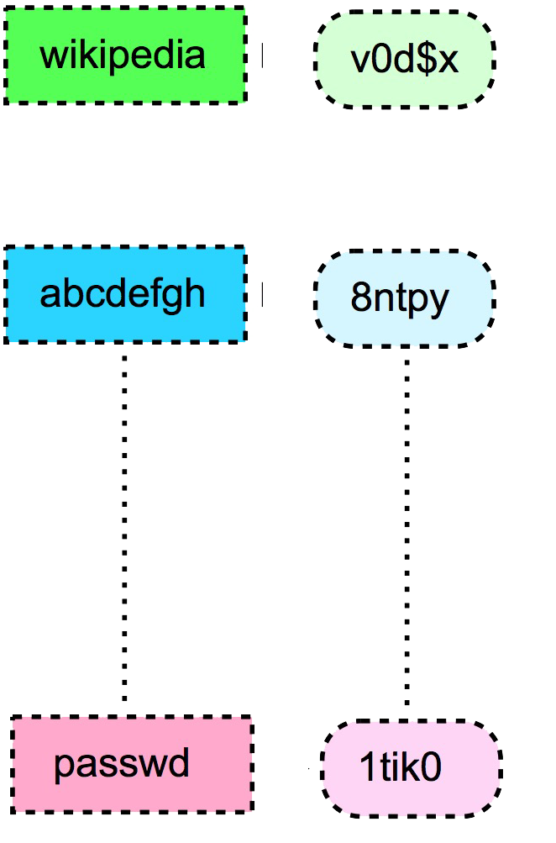
RAINBOW TABLE (HOW IT WORKS)
Store only the initial key and final hash of each row.
Middle part is easily reproducible.
Storage requirements divided by the width of the table.
Notes:
Chris B

Slide 13
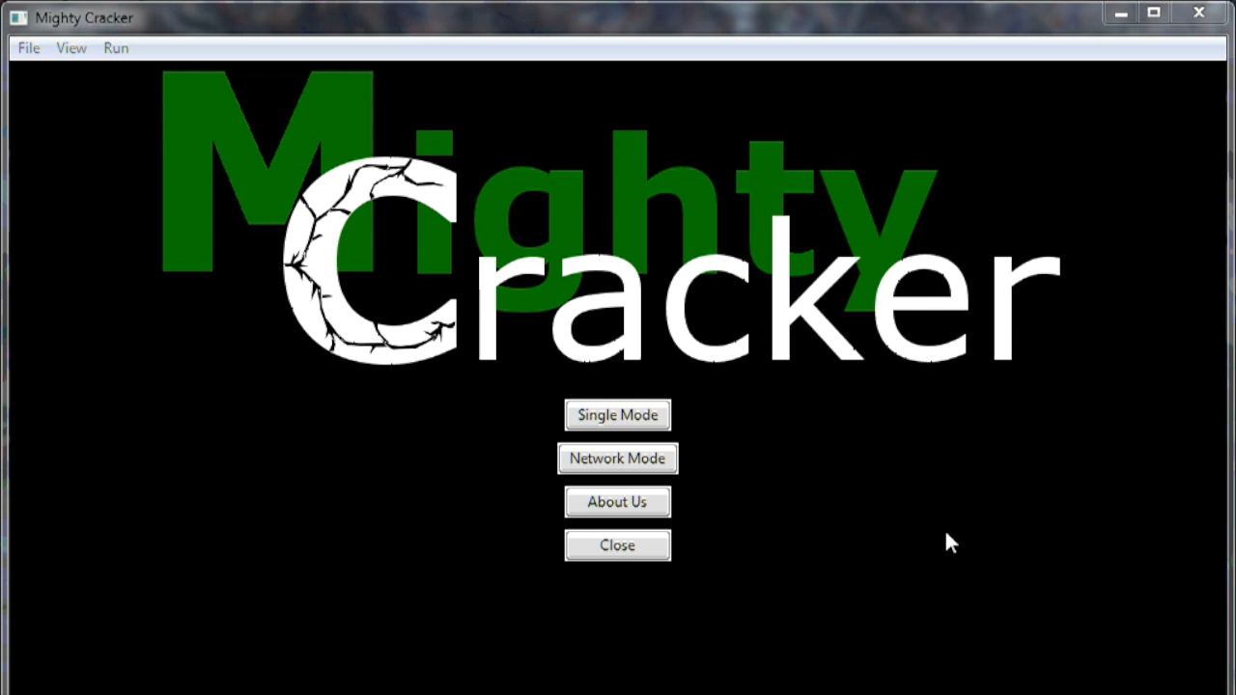
GUI DEMO

Slide 14
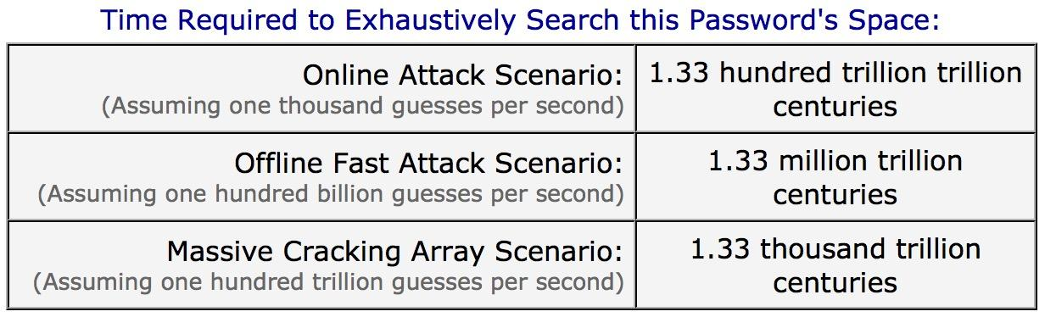
GUI DEMO
*^n1gh7^m4r3^*[*123*]
Stolen in 2009 data breach
Don’t reuse passwords.
Notes:
Ni
305e7c50cedd60d99df20ff5e3b0030e122d3bc2d175bd98560e42f73649155b

Slide 15





DEVELOPMENT
Requires Python 2.7.X
GUI Requires wxPython
Pycharm
Linux, OSX 10.6+, Windows 7+
Git
Notes:
Jon

Slide 16
WHY USE PYTHON?
♥ People love Python ♥
Easy to learn the basics and get going.
Something new compared to what we have learned.
C/C++, Java, C#, Haskell, OCaml, MySQL, Perl
Notes:
Jon
♥♥♥

Slide 17
CHALLENGES
Global Interpreter Lock (GIL) in Python
Threads Run Serially, Not in Parallel
Caused many issues for networking
Solution was Python’s multiprocessing library
Pickling
wxPython objects are not pickleable
Notes:
Chris H
Pickling: In passing an object between functions, it is often necessary to change the type of an object.

Slide 18
CHALLENGES CONTINUED
Windows support
manager conflicts
fork vs. spawn processes
pickling issues
Graphics Library
Tkinter - can’t handle complicated layouts
Solution was wxPython library
Everyone knows “a little” python
In-depth help was hard to find
Notes:
Chris H

Slide 19
FUTURE PLANS
Crash recovery
“Pause” ability
GPU Support
Real-time Client Monitoring System for Server
Re-Implement in C++
More algorithms
LM (Windows ME and before)
NTLM (Windows XP → 8.1)
Notes:
Jon

Slide 20
DEFEATING THE MIGHTY CRACKER
Strong storage algorithms
bcrypt, scrypt
Use long (12+ character) random passwords Don’t reuse passwords Two factor authentication
Password manager
KeyFree, LastPass
Notes:
Jon

Slide 21
Thank You
Ruben Gamboa
Jim Ward
StackOverflow
The Internet
Notes:
Chris B

Slide 22
QUESTIONS?

Slide 23
References
GRC’s Password Haystack - https://www.grc.com/haystack.htm
"Rainbow table1" by Dake - Dake. Licensed under CC BY-SA 2.5 via Wikimedia Commons - https://commons.wikimedia.org/wiki/File:Rainbow_table1.svg#/media/File:Rainbow_table1.svg
http://media.idownloadblog.com/wp-content/uploads/2013/06/OS-X-Mavericks-logo-full-size.jpg
http://th03.deviantart.net/fs70/PRE/f/2012/312/7/3/microsoft___windows_8_logo_by_n_studios_2-d5keldy.png
https://thinkboxly.files.wordpress.com/2012/04/linux_logo.png
http://astroleaks.lamost.org/wp-content/uploads/2012/03/Logo_Python.png
http://blog.jetbrains.com/wp-content/uploads/2014/02/pycharm_logo_square.jpg
Notes:
Chris B

